Slide 1

Containers in Python

Slide 2
Containers
Python provides several types of container that can be used to group objects together.

Slide 3
Mutable versus immutable
Mutable containers can be modified after they have been created; immutable containers cannot.

Slide 4
Ordered versus unordered
The items in an ordered container are stored in a fixed sequence; those in an unordered container are not.

Slide 5
Indexable versus non-indexable
The items in an indexed container can be retrieved using a key; those in a non-indexable container cannot.

Slide 6
Lists in Python

Slide 7
Lists
A list is an ordered sequence of objects, identified by surrounding square brackets [].
• To generate a list, enclose a sequence of objects (separated by commas) in square
brackets.
• List elements can be of any type, and can be of different types within the same list.
• Lists are mutable - once created, elements can be added, replaced or deleted.

Slide 8
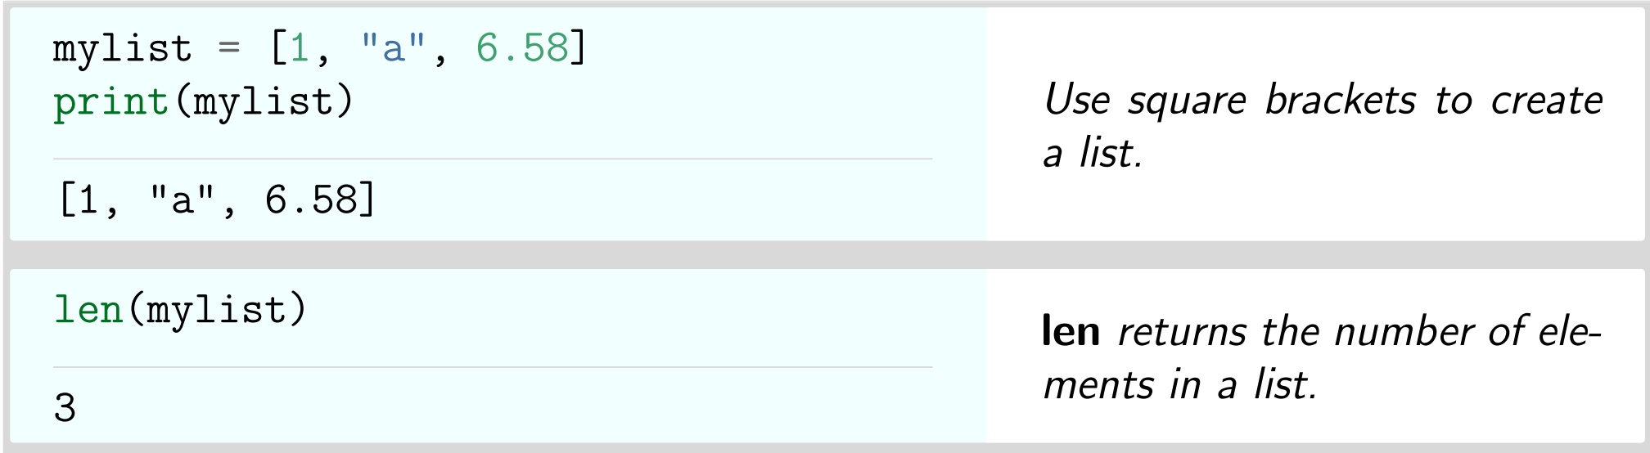
Lists

Slide 9
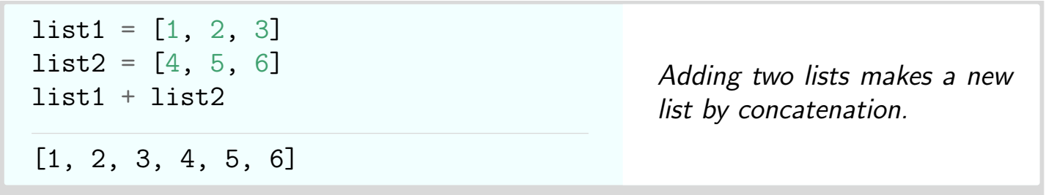
Lists

Slide 10
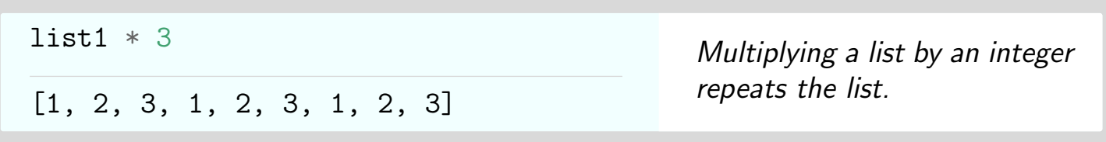
Lists

Slide 11
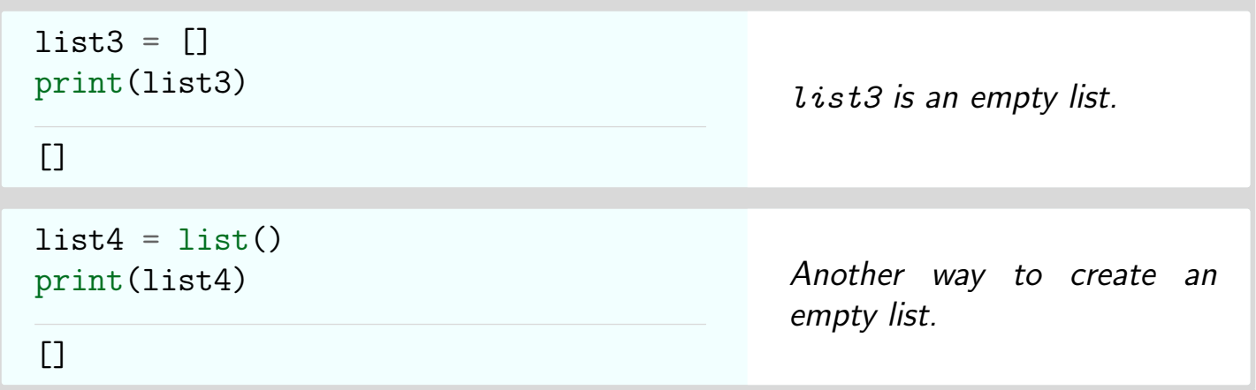
Lists

Slide 12
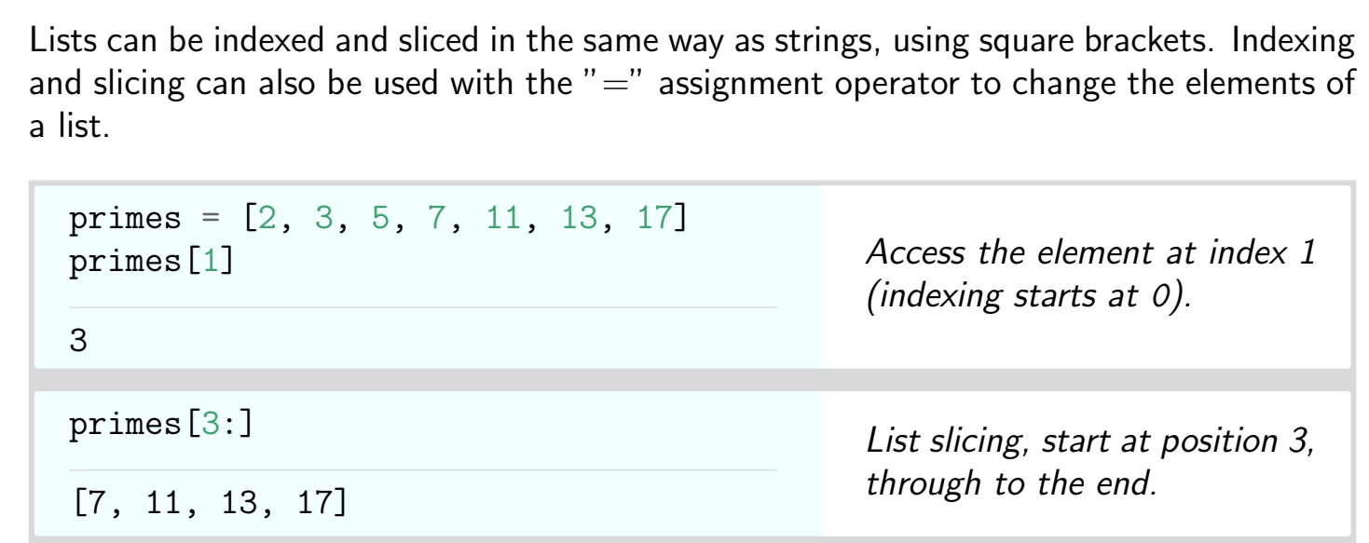
Lists

Slide 13
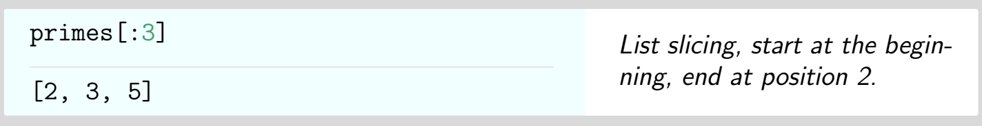
Lists

Slide 14
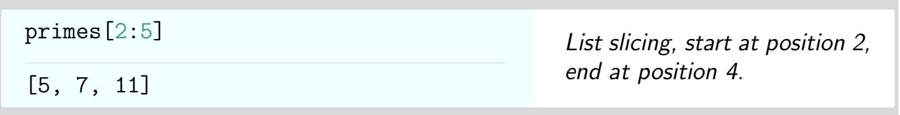
Lists

Slide 15
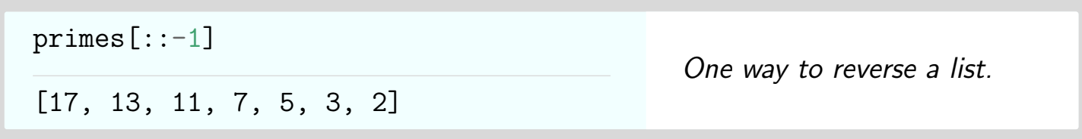
Lists

Slide 16
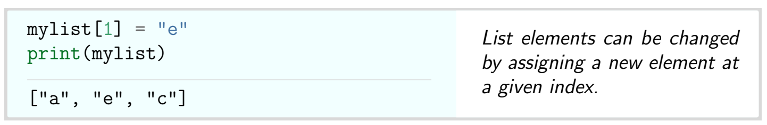
Lists

Slide 17
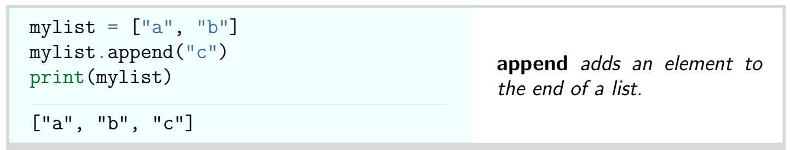
Append()

Slide 18
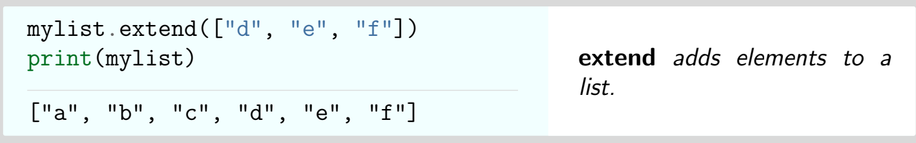
Extend()

Slide 19
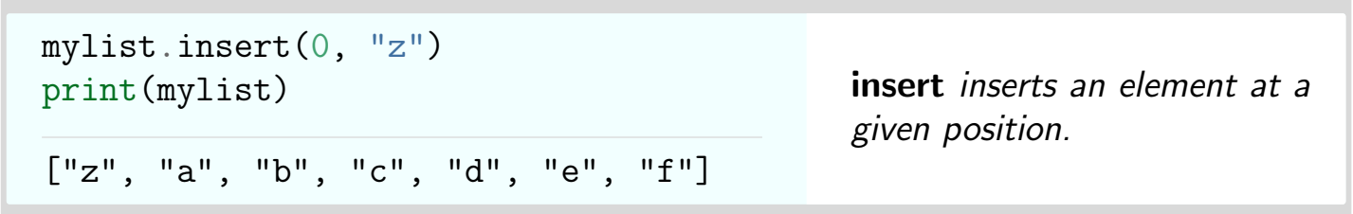
Insert()

Slide 20
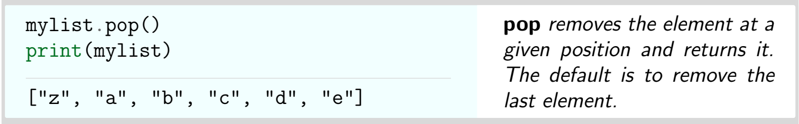
Pop()

Slide 21
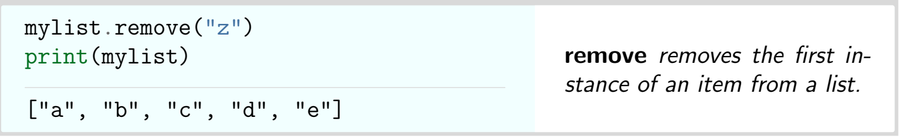
remove()

Slide 22
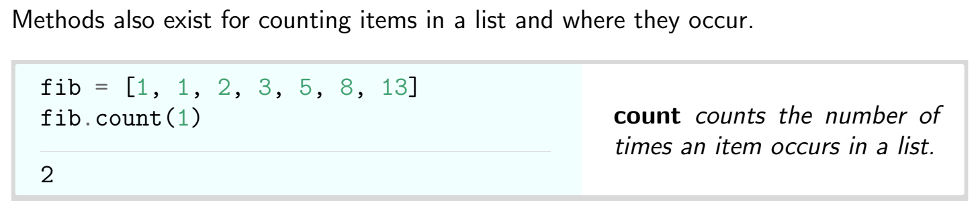
Count()

Slide 23
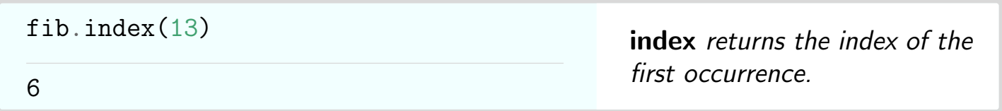
Index()

Slide 24
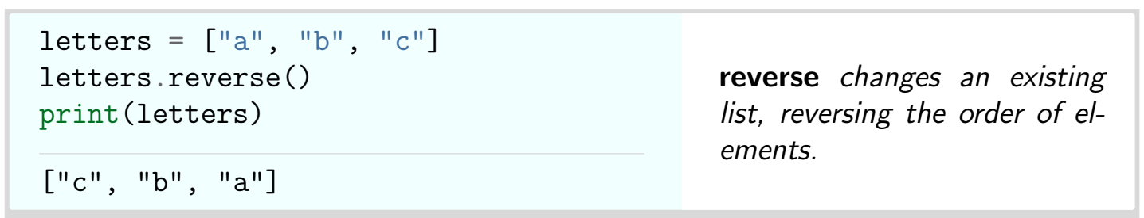
Reverse()

Slide 25
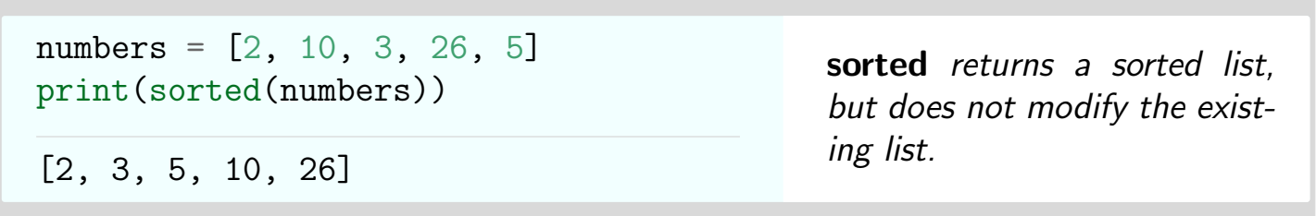
Sorted()

Slide 26
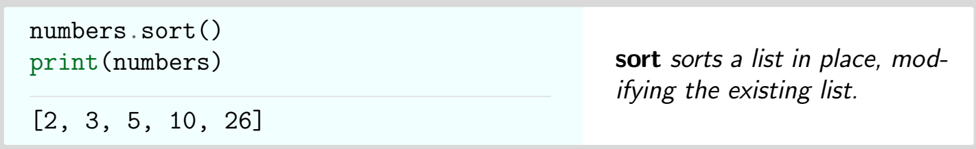
Sort()

Slide 27
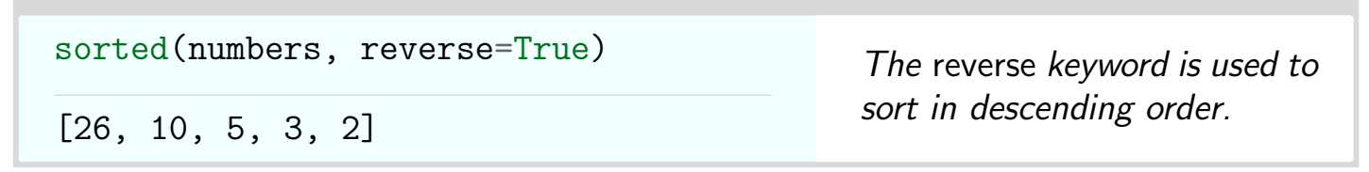
Reverse order sorting

Slide 28
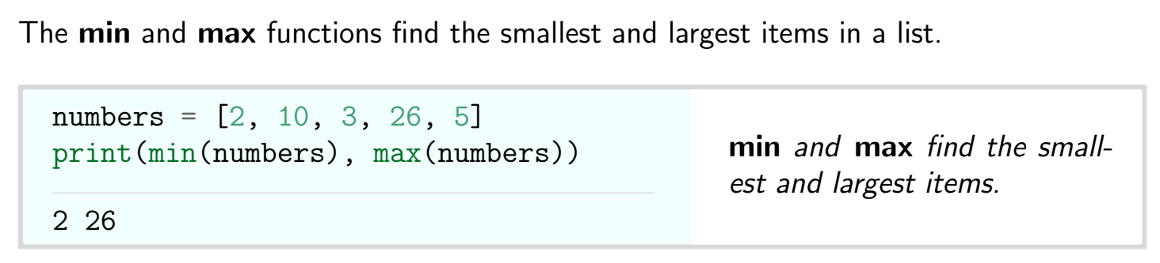
Min & max function

Slide 29
Thank You

